Slide 1


AUTOMATED VULNERABILITY SCANNER WITH AI-POWERED CLASSIFICATION AND REMEDIATION
Team Members
Umer Farooq
Jalil Ahmad
Aleena Fatima

Slide 2

Objective:
To automate the detection, classification, and remediation of vulnerabilities using OpenVAS, machine learning, and NLP.
Key Modules:
Vulnerability Scanning: OpenVAS for detecting vulnerabilities.
Severity Classification: Random Forest model for severity prediction.
Remediation Generation: AI-powered remediation suggestions using T5.

Slide 3

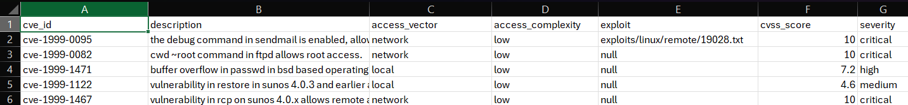
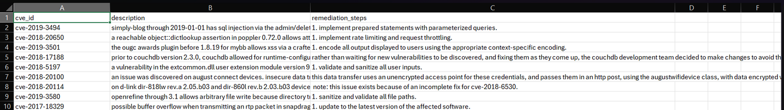
Classification Dataset:
Gathered from NVD and ExploitDB.
200,000 entries
1999 - 2025
Remediations Dataset:
Gathered from NVD and Web Scraping

Slide 4

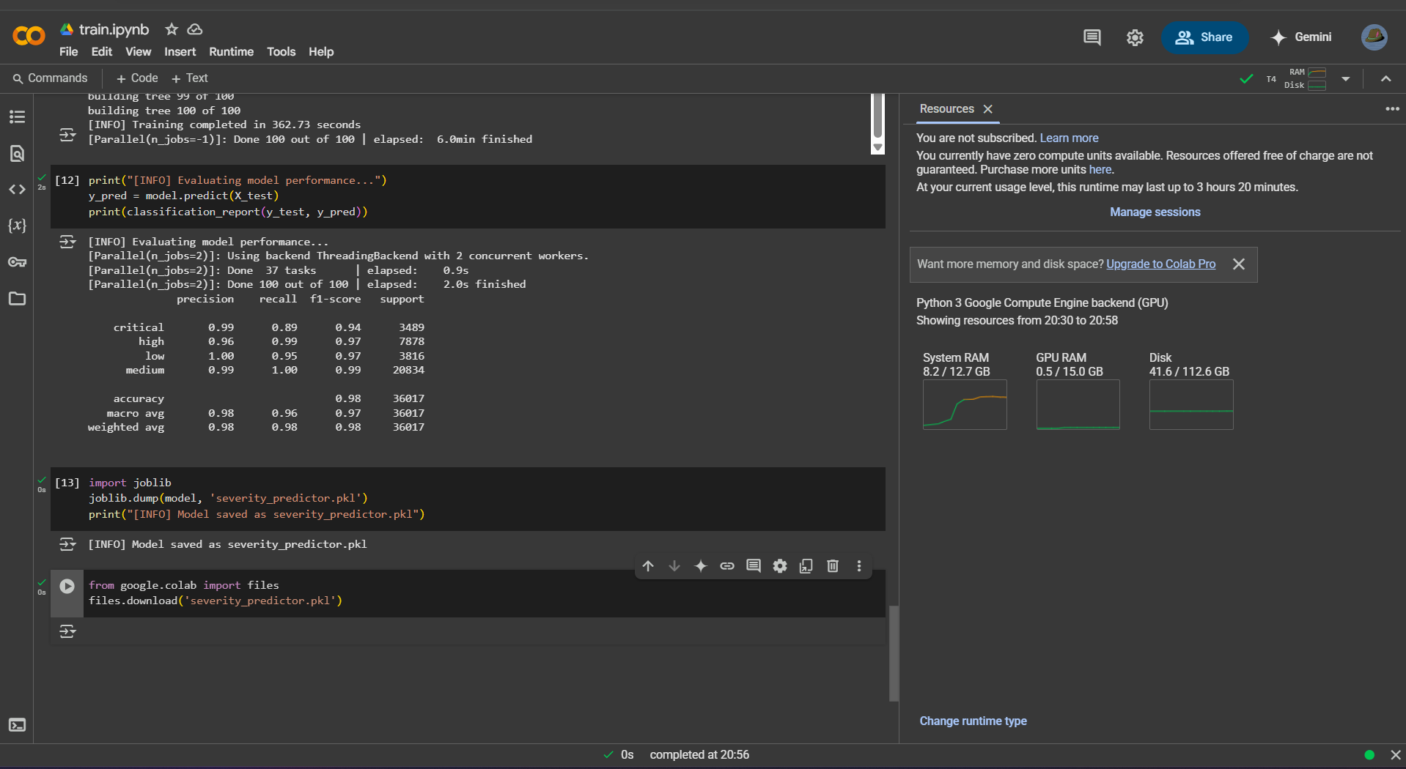
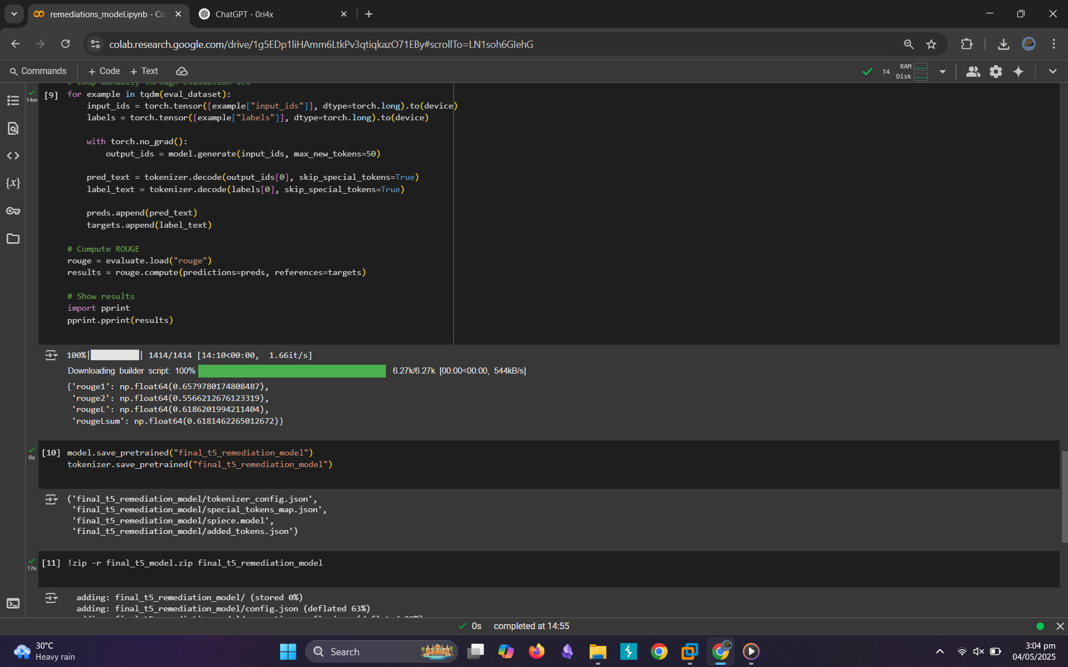
Model Evaluation Results
Classification Model (Random Forest)
Remediation Model (T5 Finetuning)

Slide 5

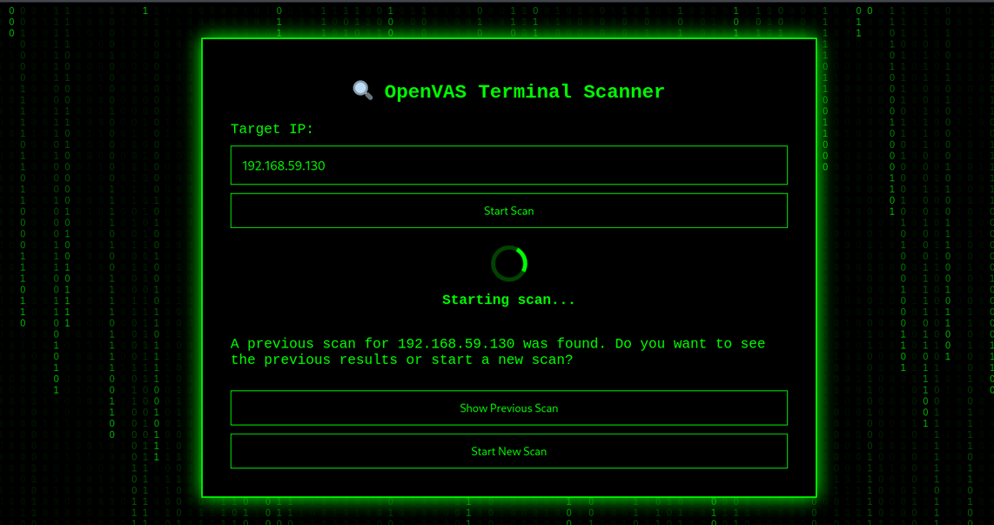
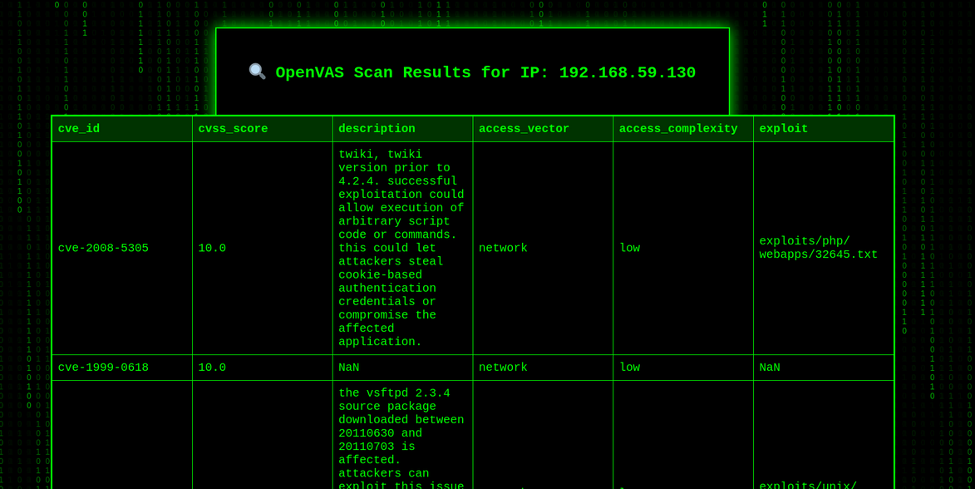
Walkthrough
Scanning
Initial Scan Results

Slide 6
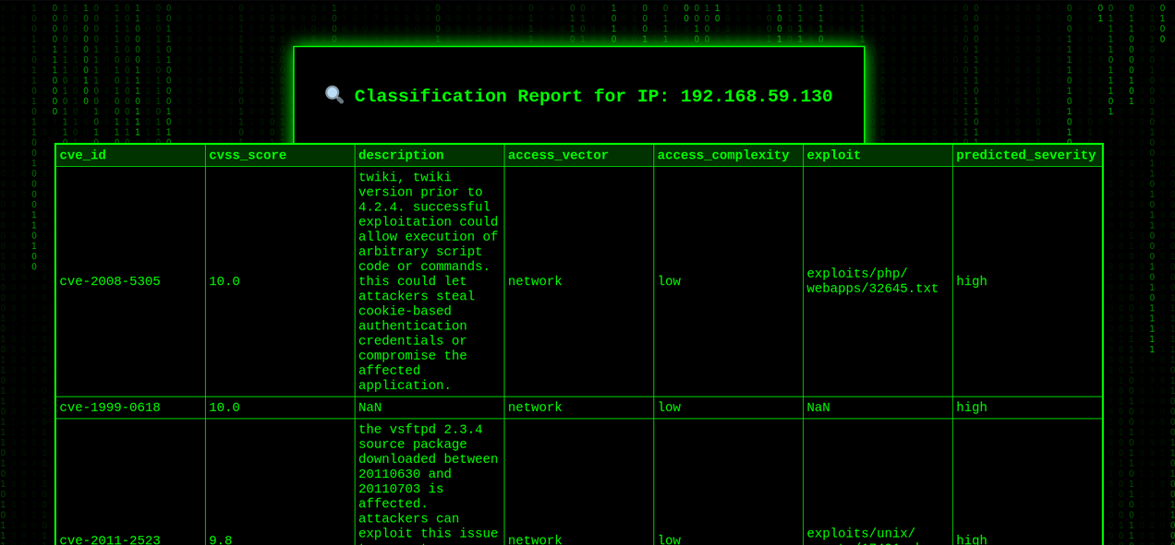
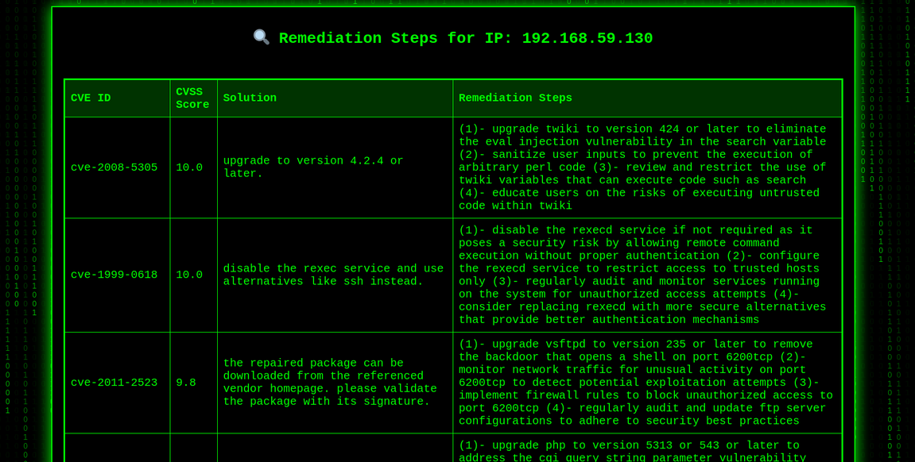
Walkthrough
Classification Report
Remediations Report

Slide 7

THANK YOU

